Slide 1
Adaptive Arena
Sprint 0

Slide 2
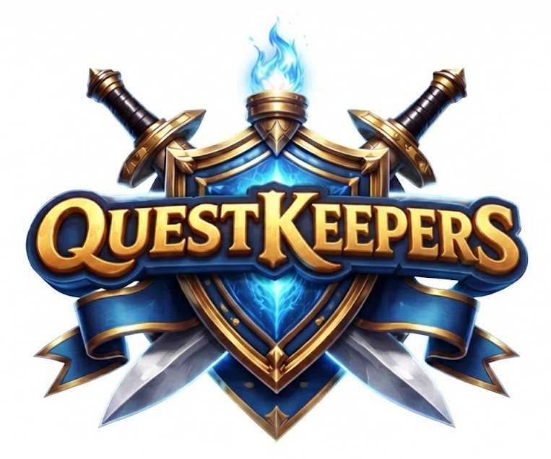
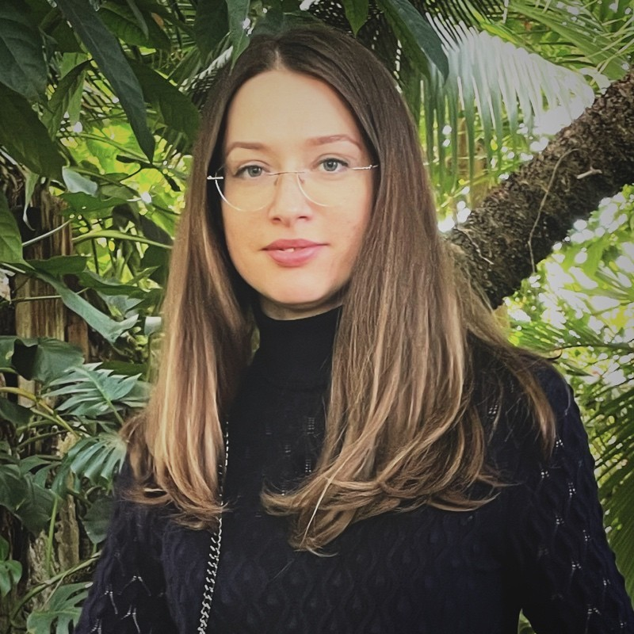
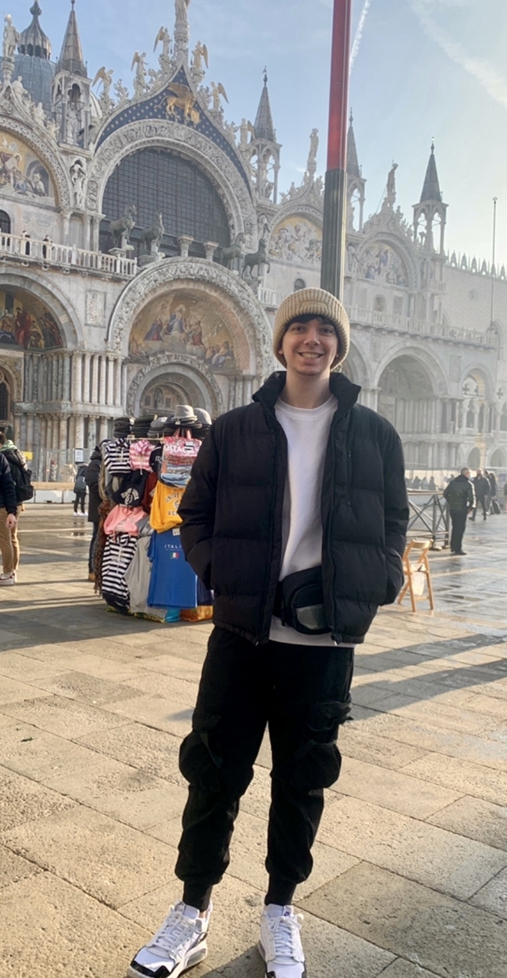
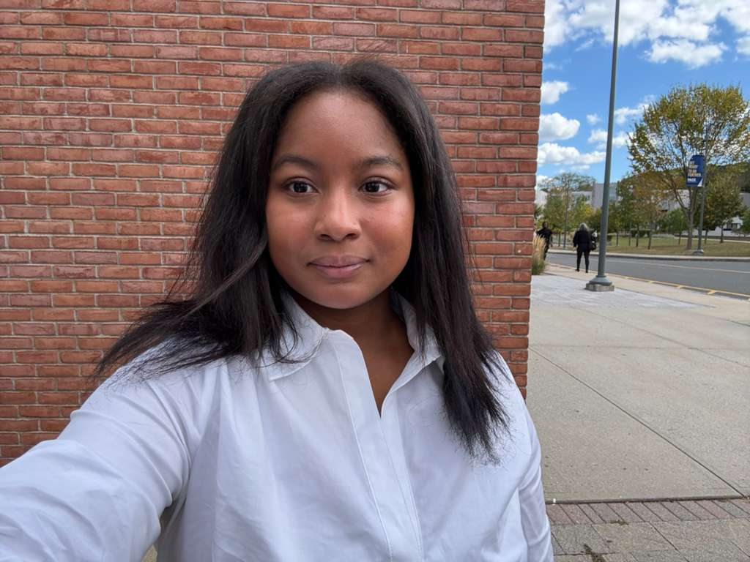
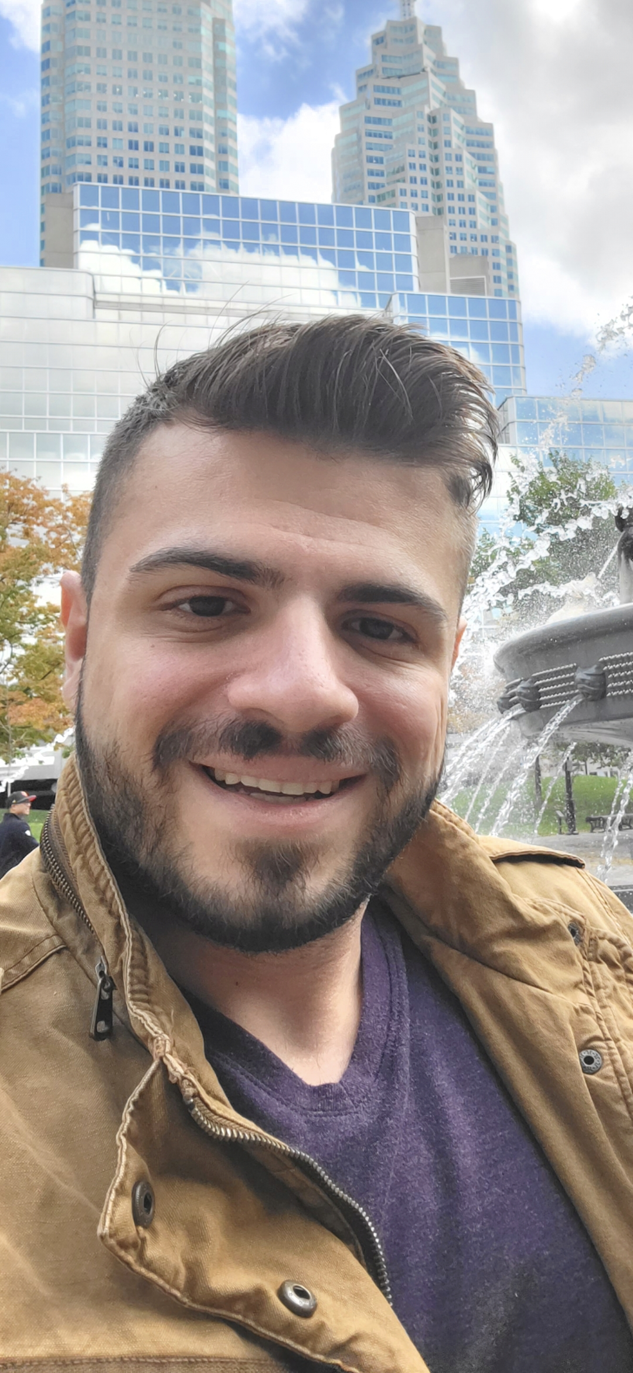
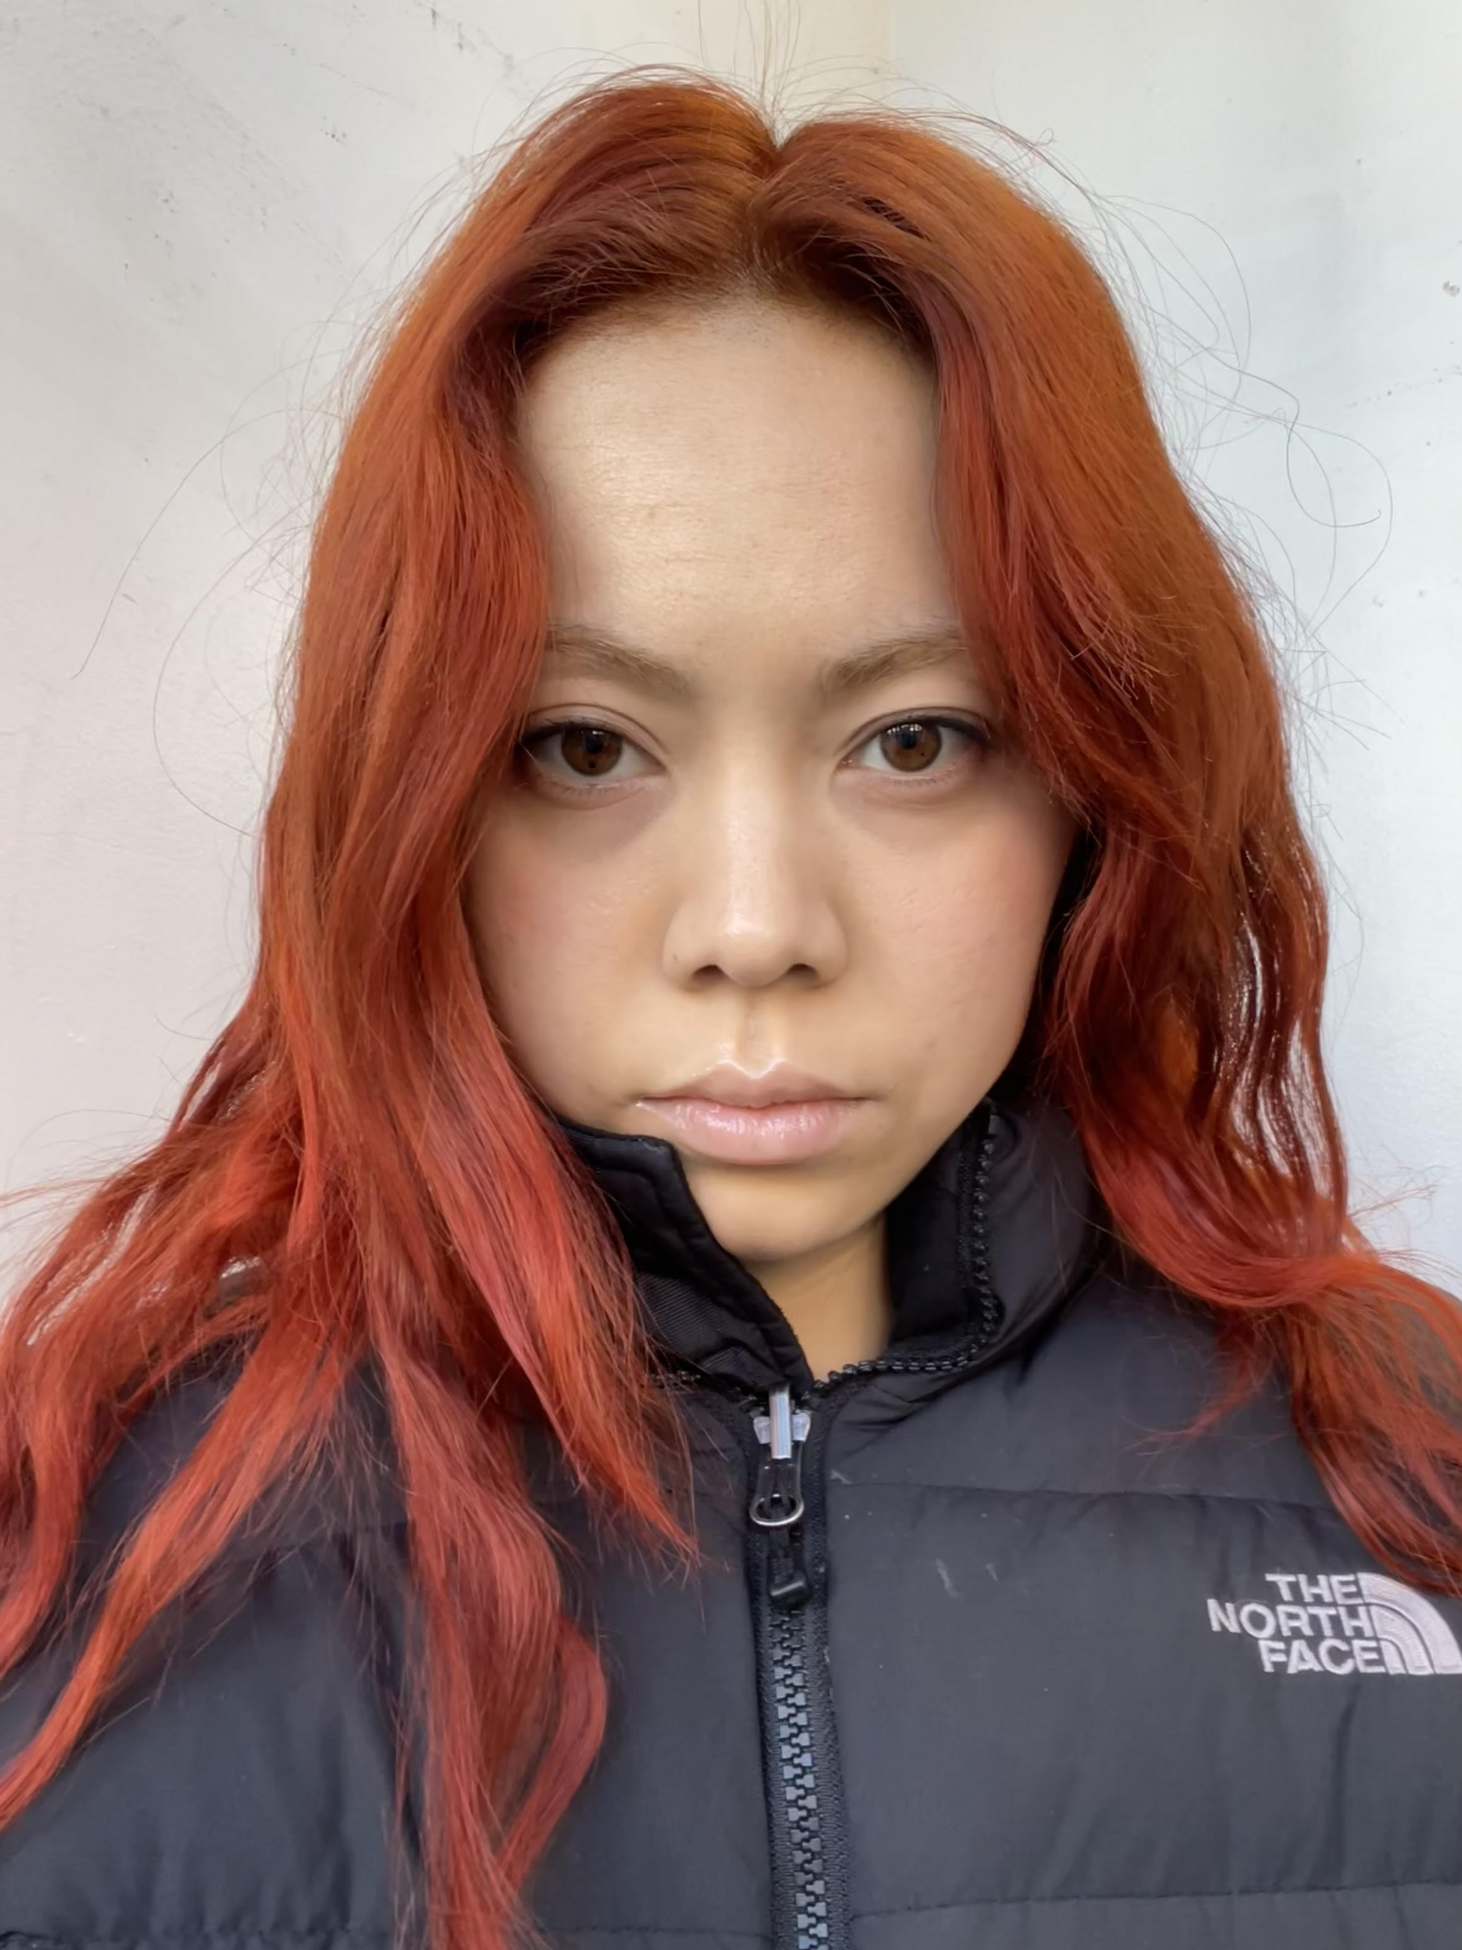
Meet The Team
Inna Ivashchenko
Project Manager / Developer
Johnhenry Brayman
Lead Game Developer
Shariah Allen
Game Developer / AI Engineer
Anthony Piombino
QA Engineer
Gabrielle Schwan
UI/UX Developer

Slide 3
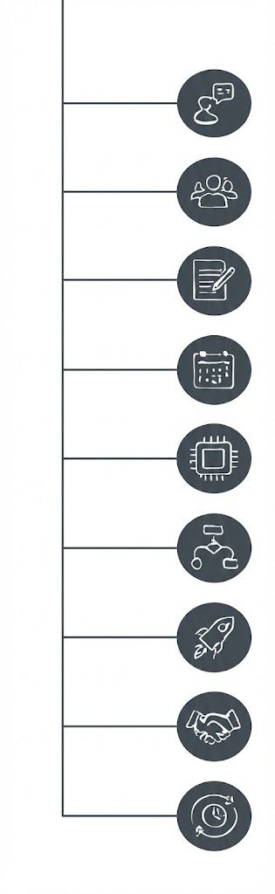
Problem Statement
User Personas
Project Description
Project Timeline
Technologies
Algorithms
Minimum Viable Product
Working Agreement
Sprint 0 Retrospective
Agenda

Slide 4
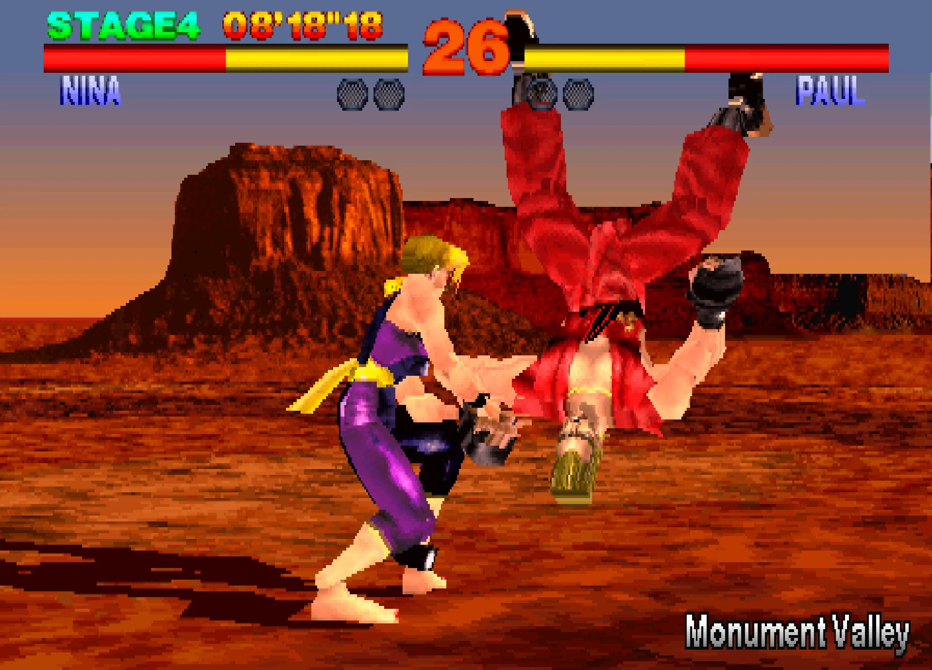
Problem Statement
Competitive fighting games are typically daunting for newer players since most skills are transferable across the different titles.
At the same time, more experienced players lack a consistent opponent to learn from and advance their skills.
How can we create a compelling game that scales to our player's skill level and creates enjoyment for all users while encouraging high replay value?

Slide 5

User Personas: The Competitive Gamer
Name: Anna Grace
Age: 28
Gender: Female
Occupation: Game Developer & Twitch Streamer
Anna is a season game developer with a solid fan base, that enjoys playing games in her free time, specifically fighting, first-person shooters (FPS), and racing games. She’s often searching for new and exciting games that have varying difficult levels and unique features that keeps players engaged.
Challenges:
Tired of playing the same popular titles, with reoccurring characters and stories
Wants to find new games developed by small teams to stream for her community
Goals:
She enjoys playing games and learning different mechanics
Wants to explore new games with AI elements
Seeks a game that can be replayed several times
Quote:
“ I just want to entertain my community and learn new skills; I love a good challenge!”

Slide 6
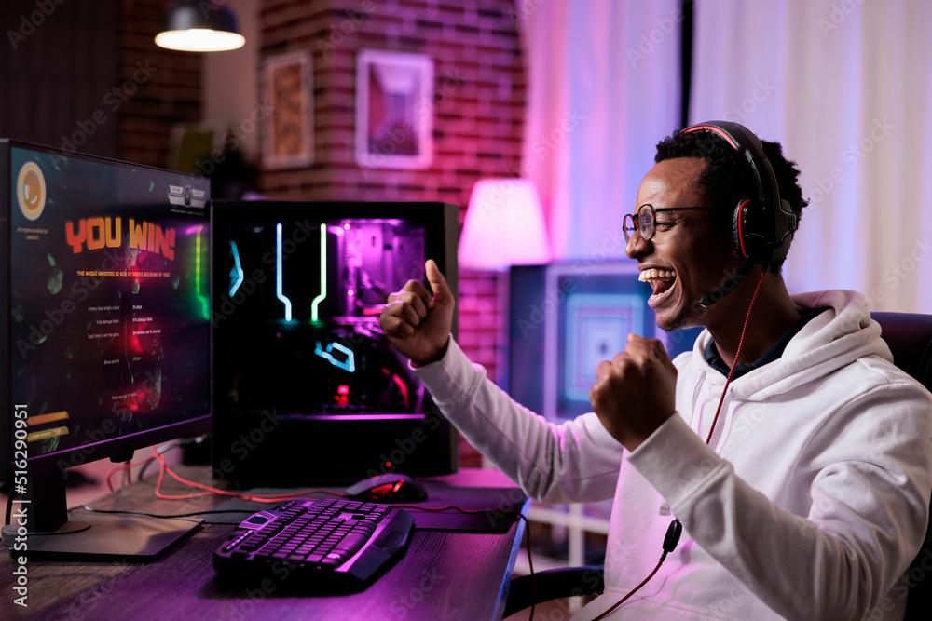
User Personas: The Button Smasher
Name: Jordan Carter
Age: 19
Gender: Male
Occupation: Undergraduate Student and Student Athlete
Jordan is a busy student athlete studying animation, that loves to play games on his free time on the weekends or while hanging out with friends. He loves playing games with lots of action, unique characters, and prefers to not memorize combos but just plays for fun, not to win.
Challenges:
Complex inputs and combinations makes gameplay frustrating
Long or vague tutorials
Goals:
Have fun solo or with friends
Win occasionally, or access to varying difficulties
Quote:
“ I skip tutorials, I just want to have mindless fun!”

Slide 7

User Personas: The Lore Explorer
Name: Dylan Taylor
Age: 12
Gender: Male
Occupation: Middle School Student
Dylan enjoys playing games after school with friends, family, or by himself, and specifically enjoys games that are action-packed. He seeks out games that provide a good challenge, has lots of enemies, and visual stimulation. He aspires to be a game developer and enjoys learning how to make 2D games during his video game club meetings.
Challenges:
Hard to find action games that are age appropriate
Wants games with unique enemies
Prefers 2D games
Goals:
Wants to explore new action games
Age-appropriate game with visual stimulation
Quote:
“ Games are fun when they have a lot of action!”

Slide 8
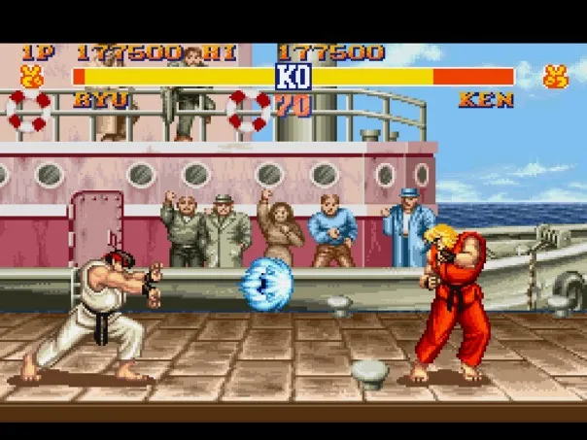
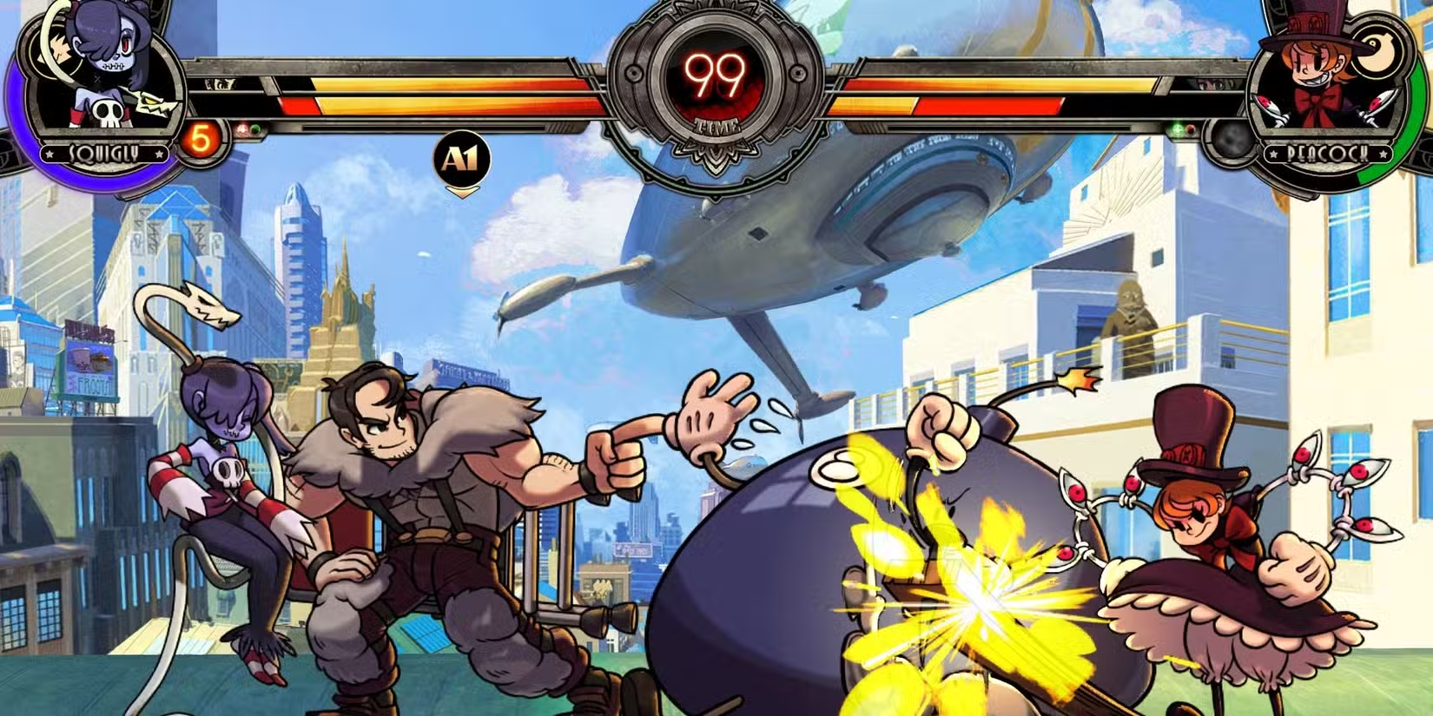
Project Description
2D-fighting game focusing primarily on AI opponents and improving your general fighting game skills.
AI will scale appropriately based on selected skill level
Easy : Mostly random or suboptimal moves
Medium : Basic strategy with a little randomness
Hard : Uses machine learning to adapt and respond
Provide user-friendly interface for user entry
Tally up and output results of game

Slide 9

Project Timeline
Sprint 0
Sprint 1
Sprint 2
Sprint 3
Determine project topic
Solidify project details and draft artifacts
Demonstration of MVP
Draft tech paper and artifacts
Submission of final technical paper, deployment, and user manual
Determine job roles
Demonstrate interactive product with improvements
Demonstrate working interactive product
Create and update wiki
Update wiki
Update wiki
Update wiki
Conduct video presentation and retrospective
Conduct video presentation and retrospective
Conduct video presentation and retrospective
Conduct video presentation and retrospective

Slide 10




Technologies
Unity 6.3 LTS
Git LFS Extension
C# Programming
Python (for Machine Learning)

Slide 11
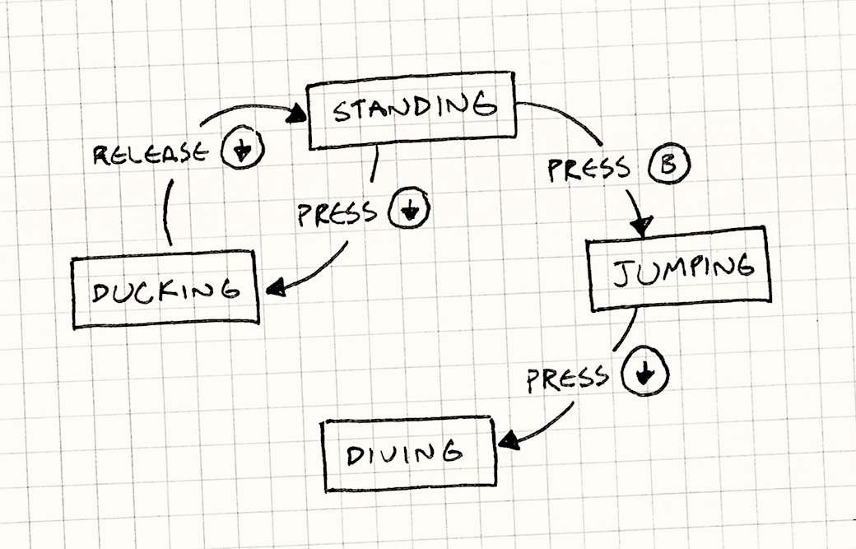
Algorithms
Easy Difficulty : Randomized Finite State Machine
The enemy AI is presented with multiple pre-defined states (Idle, Attack, Advance, Block, Duck).
Instead of using strategy, it picks which state to move to next randomly.
Attacks and movements still make sense but are suboptimal.

Slide 12
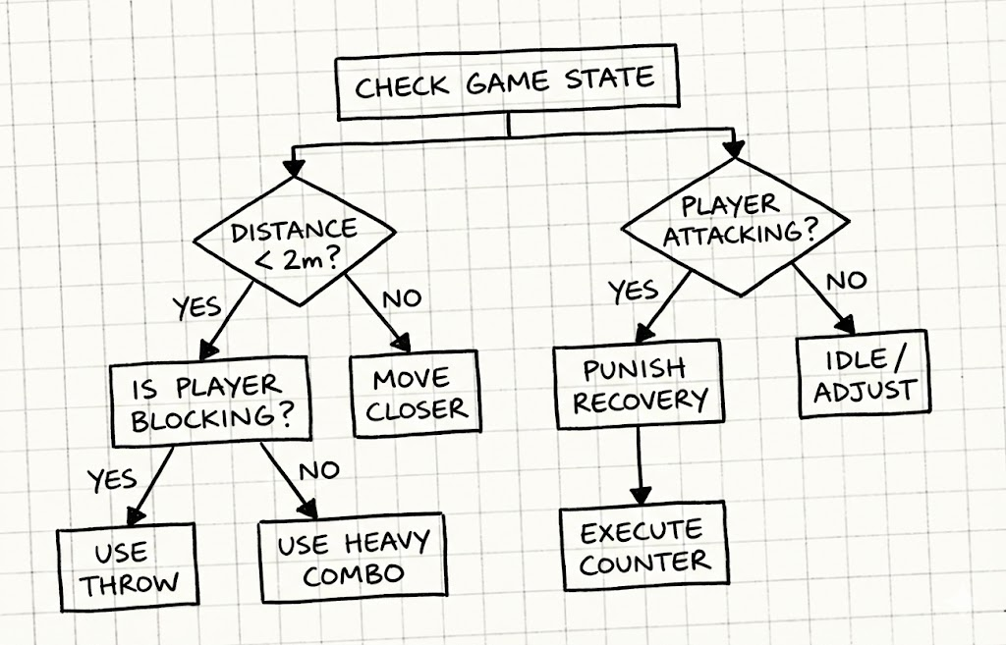
Algorithms
Medium Difficulty : Decision Trees
The enemy AI in this difficulty will start to react differently depending on certain criteria.
Before making an action, it will check a specific condition and act accordingly.
Can still make random decisions but in a more educated way.
Ex. Check to see if the player is attacking. If yes, randomly choose between block or counter.

Slide 13
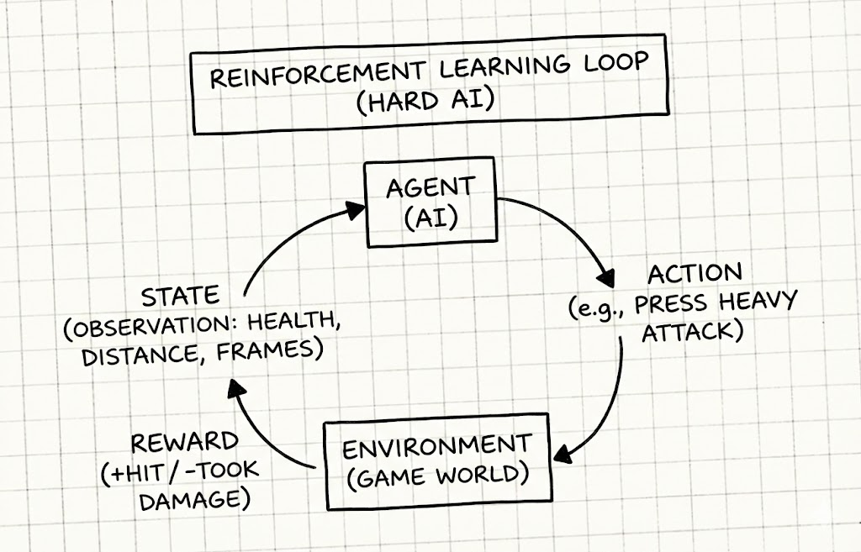
Algorithms
Hard Difficulty : Reinforcement Learning
The enemy AI will fight through many simulations either against itself, or one of the before mentioned difficulties.
It will receive a reward (+1) for landing a hit on the player, and a punishment (-1) for being struck by the player.
The AI will learn which actions lead to rewards and which actions lead to punishments.

Slide 14
Minimum Viable Product (MVP)
The Environment:
The Combat System:
A simple flat ground with invisible walls on each side to prevent falling off.
A basic camera with a script that keeps both players in-frame while zooming in as close as possible.
The bare minimum controls will be Locomotion, an Attack action, and a Block action.
Possibility to include combos, ducking, countering, and throwing later.
The AI Difficulties:
The Game Flow:
For the rules-based difficulties, the State Machine and Decision Tree logic must work, even if they are not complex.
For the hard difficulty, the Unity Agent must be able to read observations and output actions from the Neural Net.
The player must be able to enter the game from a main menu and select an AI difficulty.
In-game must show health bars depleting, and a return to the main menu when one character reaches zero.

Slide 15
Team Working Agreement
Communication And Responsibilities:
Communication through WhatsApp.
All team members must respect each other and have the right to contribute their ideas to the project.
All ideas, vision and changes discussed together, and final decisions are up to most of the team, except urgent situations.
Each person works within the boundaries established before the start of work.
Everyone is responsible for their own part.
All conflicts should first be resolved between the people involved. If that is not possible the issue should be brought to the Team Lead.
Each member must inform the team about any changes or improvements they make.
Meetings:
Meeting happens through ZOOM or WhatsApp
The team must have Scrum meetings two times in a week and check WhatsApp daily to avoid missing any project information.
Schedule of a Scrum meeting : Monday at 10am and Saturday at 10am
Each team member should participate in at least one meeting per week unless they have an important reason.

Slide 16
Retrospective
Team Strengths
Open to each other’s ideas
Team was flexible and responded quickly
Prioritize tasks and follow the plan
Everyone achieved their responsibilities
Quickly adapt to new requirements
Team Weaknesses
Communication in the team chat was not updated by everyone
We must work on time management
Learn new skills to improve the project
Work structure was not created, and communication was a bit chaotic
Improvements
Implement a framework for meetings (e.g., Trello)
Improve team communication
Participate in weekly Scrum meetings
Use innovative tools and receive new knowledge
Update task status at least twice a week

Slide 17
Wiki Page Link
https://github.com/htmw/2026SA-QuestKeeper/wiki

Slide 18
Thank You

